Slide 1
Databases and Data Dashboards – A comparison of a locally hosted, free database and dashboard (MySQL/Excel) vs Amazon RDS/Amazon QuickSight dashboard
Jack K. Rasmus-Vorrath, SMU MS Data Science student
Nicole Shaver, SMU MS Data Science student
November 27, 2017

Slide 2
Why Dashboards?
Dashboards are visualization tools designed to display and share info on key indicators relating to a predetermined business question
Dashboard development should bear this question as well as the needs of end users in mind; they are not unspecified tools for analytical exploration
Discovering insights is the job of a data scientist or analyst. Dashboards are for monitoring/representing/sharing/communicating that insight to project collaborators and stakeholders
Use cases may include: supporting tactical decision; troubleshooting process completion; finetuning resource allocation; identifying efficiency gains; and observing relevant data trends on variables of interest

Slide 3
Dashboard Options
Big data is big money, and start-ups want cost-effective solutions
Open-source tools can handle more data more cheaply, but at a performance cost
The trade-offs often include speed, training and customizability, as well as shareability issues
Proprietary webservers are fast.
Inexpensive stand-alone and open-source dashboards development tools support fine-grain customizability provided end user know-how.
Paid services like Amazon RDS are designed to streamline workflow and facilitate info sharing at various organizational levels (including mobile device support, which not all open-source options offer)
The driving questions are: who is using your dashboard and why? What do they need to know to accomplish their goal, and what should they be able to do to better glean/communicate that knowledge and render it actionable? Dashboard design serves, rather than identifies the business problem.

Slide 4
Project Goals
Create a normalized MySQL database (on a local server) from a flat file data source
Create a normalized MySQL database on the cloud (Amazon RDS)
Create a free dashboard in MS Excel
Create a dashboard in Amazon Quicksight
Compare MS Excel/local MySQL dashboard/database and Amazon Quicksight/Amazon RDS MySQL for cost, ease of setup, ease of creation, customizability, shareability and update speed.

Slide 5
Tools Used
MySQL
Amazon RDS (account set up)
Amazon Quicksight
Microsoft Excel

Slide 6
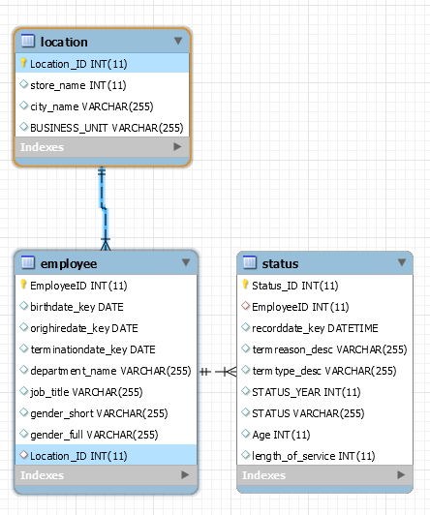
Database Solution—EER Diagram

Slide 7
Turning the csv file into MySQL
USE mydb;
DROP TABLE if exists mydb_raw;
CREATE TABLE mydb_raw (
EmployeeID varchar(255),
[…]
LOAD DATA LOCAL INFILE ‘C:/ […]
INTO TABLE mydb.mydb_raw […]
DROP TABLE if exists mydb.proc;
CREATE TABLE mydb.proc (
EmployeeID int,
[…]
INSERT INTO mydb.proc (
EmployeeID,
[…]
SELECT EmployeeID,
STR_TO_DATE(recorddate_key, '%c/%e/%Y %k:%i’), […]
FROM mydb_raw as T; […]
DROP TABLE if exists mydb_raw;
DROP TABLE IF EXISTS mydb.status;
DROP TABLE if exists mydb.employee;
DROP TABLE IF EXISTS mydb.location;
CREATE TABLE `location` (
`Location_ID` int(11) NOT NULL AUTO_INCREMENT, […]
INSERT INTO mydb.location (
city_name, […]
SELECT DISTINCT city_name,
[…] FROM mydb.proc
CREATE TABLE `employee` (
`EmployeeID` int(11) NOT NULL,
[…]
INSERT INTO mydb.employee (
EmployeeID, […]
SELECT DISTINCT EmployeeID, […]
FROM mydb.proc;
CREATE TABLE `status` (
`Status_ID` int(11) NOT NULL AUTO_INCREMENT,
[…]
INSERT INTO mydb.status (
EmployeeID,
[…]
SELECT DISTINCT EmployeeID,
[…] FROM mydb.proc;
UPDATE mydb.employee a
INNER JOIN mydb.proc b
ON a.EmployeeID = b.EmployeeID
INNER JOIN mydb.location c
ON b.store_name = c.store_name
AND b.business_unit = c.business_unit
SET a.location_id = c.location_id;

Slide 8
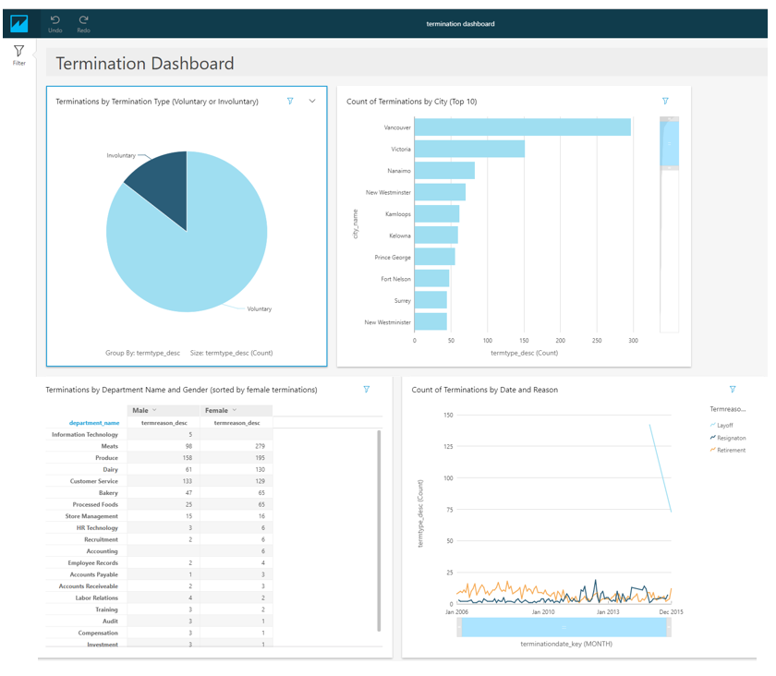
Amazon QuickSight
Link: https://us-east-1.quicksight.aws.amazon.com/sn/dashboards/09615dc4-86d3-40ba-89ff-5337dd3f1723

Slide 9
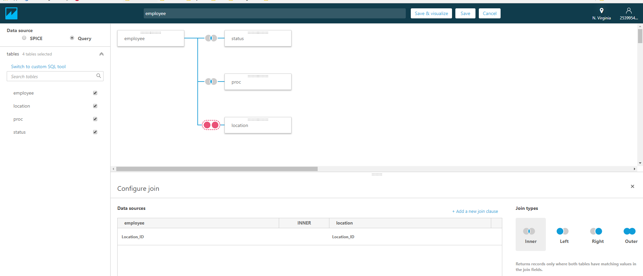
Amazon QuickSight-Joining data tables for use in dashboard
Custom Join interface—select your tables, and then join the tables by selecting the appropriate columns. Save and visualize when done.

Slide 10
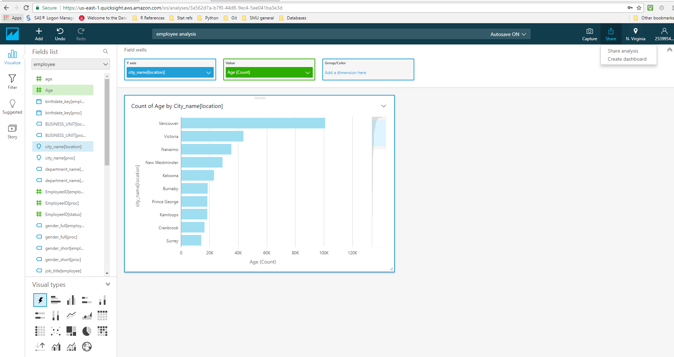
Amazon QuickSight-Creating the Dashboard
Create and then share dashboard
Choose fields
Customize Fields
Choose graph type

Slide 11
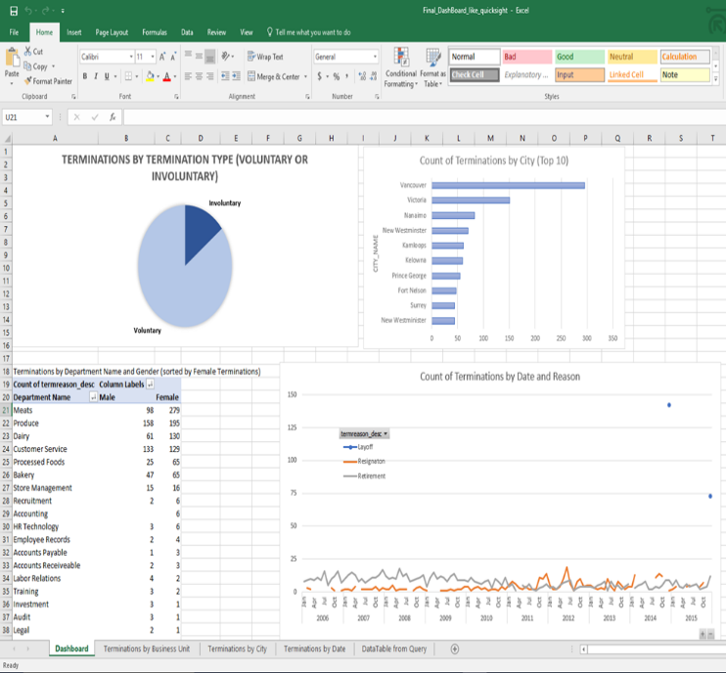
Excel Dashboard

Slide 12
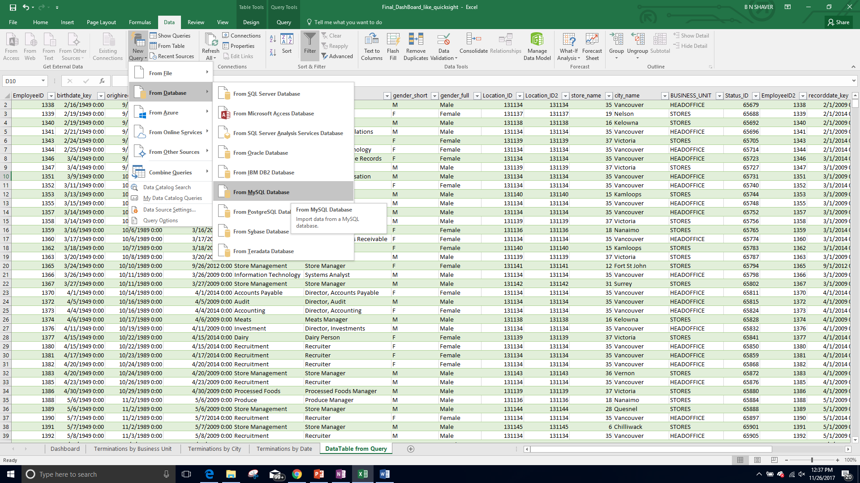
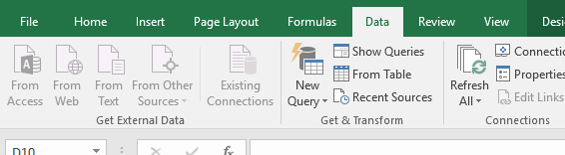
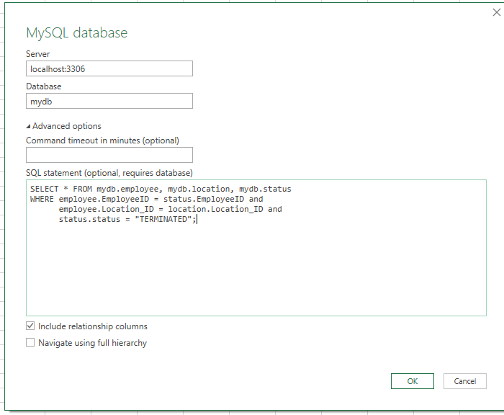
Excel Dashboard-Pulling in and refreshing the data
To pull in the data: Data, New Query, From Database, From MySQL Database
To pull refresh the data: Refresh All
Add connection info and SQL query

Slide 13
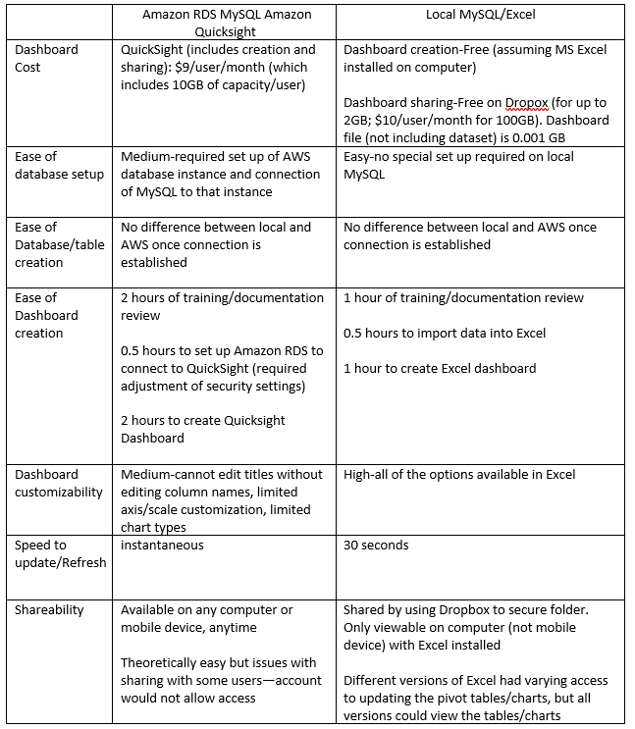
Comparison of Dashboard Solutions

